Slide 1

ISEE Project – Team DroidKnights
Final milestone - Product presentation
Presented by - Anjan Chatterjee

Slide 2
Contents
ISEE Project - Team DroidKnights
Milestone #5 - Product Presentation
01
02
03
Project retrospective
Requirements
Key features
Milestone overview and highlights
Customer requirements summary
Main features of our app that stands out
04
05
06
Getting started
User reviews
Lessons learned
Basic app info and steps to start using our app
App review from actual users
Lessons we have learned working as a team

Slide 3
01
Project retrospective
ISEE Project - Team DroidKnights
Milestone #5 - Product Presentation
Accomplishment per milestone, overview and highlights

Slide 4
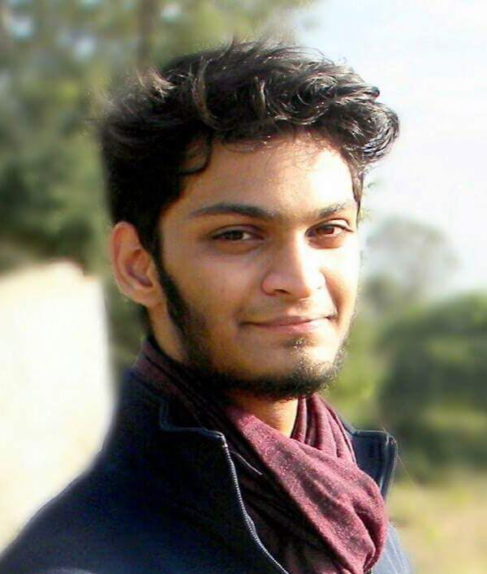
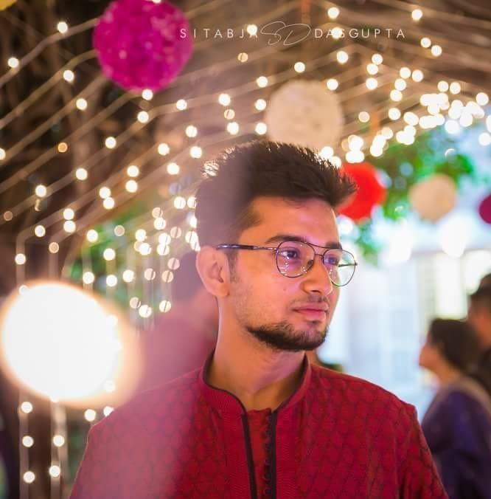
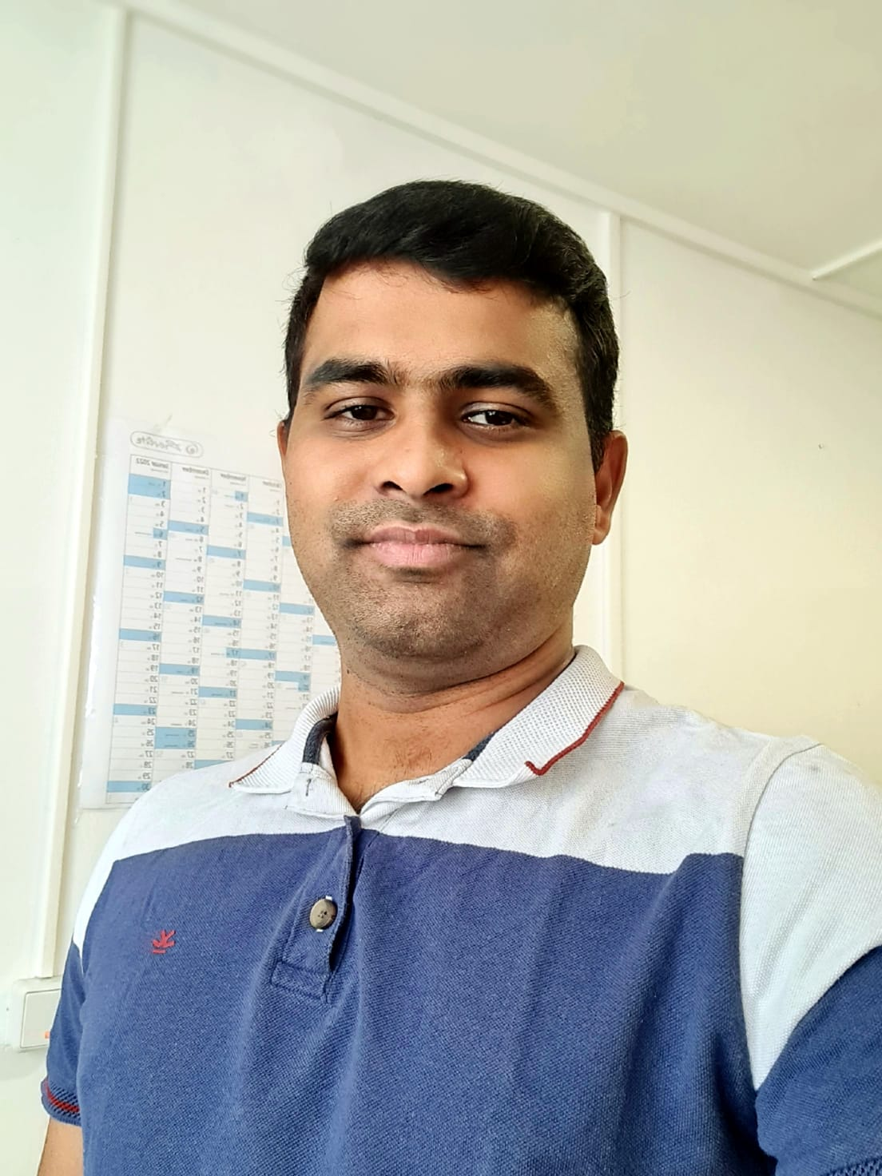
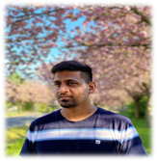
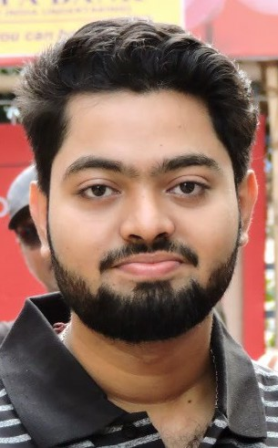

ISEE Project - Team DroidKnights
Milestone #5 - Product Presentation
Team presentation
Denzil Correa
M. Sc. Operations Research and Business Analytics
Abhirup Roy
M. Sc. Digital Engineering
Harshavardhan Reddy
M. Sc. Digital Engineering
Indarapu Sreekar Kumar
M. Sc. Digital Engineering
Anjan Chatterjee
M. Sc. Digital Engineering
Team presentation
Basic Prototype
Advanced Prototype
Beta Prototype
Product Presentation

Slide 5
ISEE Project - Team DroidKnights
Milestone #5 - Product Presentation
Basic prototype
First phase of Requirements Analysis and getting used to the Android Studio Environment.
Stepping into Class Diagrams, User Case Scenarios and Activity Diagrams.
Developing the essential features, with some necessary features.
Selection of the database for usage of the application, i.e Firebase.
Maintaining Agile methodology of development and completing the basic prototype.
Presenting the working prototype video.
Team presentation
Basic prototype
Advanced prototype
Beta prototype
Product presentation

Slide 6
ISEE Project - Team DroidKnights
Milestone #5 - Product Presentation
Advanced prototype
Overview of the design pattern used in organizing our code.
Brief introduction to coding conventions used in our code.
Introduction to users who might be using our application with the help of user profiles.
An overview of all the design solutions introduced in the application for better customer experience.
GRID layout, Security, Number Keypad, Help tab, Analytics.
Team presentation
Basic prototype
Advanced prototype
Beta prototype
Product presentation

Slide 7
ISEE Project - Team DroidKnights
Milestone #5 - Product Presentation
Beta prototype
What is Software Testing and why is it needed?
Discussed some good testing techniques.
Software Testing process.
White-Box testing, branch and condition coverage.
Black-Box testing, test cases on user requirements.
Updates in the app based on test results.
Team presentation
Basic prototype
Advanced prototype
Beta prototype
Product presentation

Slide 8
02
Requirements
ISEE Project - Team DroidKnights
Milestone #5 - Product Presentation
Final customer requirements summary

Slide 9
Customer requirements
ISEE Project - Team DroidKnights
Milestone #5 - Product Presentation
Essential
Different categories
Date
Notes per entry
Payment option
Filters
Easy to enter numbers
Currency selection
Offline capability
Necessary
Icons
Deleting entries
Repeating transactions
Thresholds
Password
Start screen indicating app about
Access to contacts
Export/Import data
Nice to have
Currency conversion
Help menu
Costs in charts
Computing average
Credit additional to debit
Notifications
Several projects
Simple recommender

Slide 10
03
Key features
ISEE Project - Team DroidKnights
Milestone #5 - Product Presentation
Main features of our app that stands out from others

Slide 11
ISEE Project - Team DroidKnights
Milestone #5 - Product Presentation
Splash Screen Animation
Login/Registration Activity
Our Approach towards the application was to stress upon thresholds/budgets and savings associated to the expense!!
Single login per user in a device
Double tap back button to exit
Grid Layout (For Main Activity)
Layout Inflation (Data Input)
Offline Capabilities in Application

Slide 12
04
Getting started
ISEE Project - Team DroidKnights
Milestone #5 - Product Presentation
Basic app info and steps to start using our app

Slide 13
AApp info
About
Steps to start
01
02
03
04
05
ISEE Project - Team DroidKnights
Milestone #5 - Product Presentation
Age group
Category
In-app purchases
Version
Updated on
Download size
Offered by
Permissions
All ages
Finance
Free
1.0
04.07.2021
9.82 MB
OvGU Magdeburg
Network access, contacts
A simple app to track your daily expenses based on your monthly budget. Easy to use interface with nice analytics to manage your personal wealth.
Download the app from this link:
https://cutt.ly/HmlkYe6
Register with an email address.
Set your monthly budget.
Update your expenses daily.
Refer help tab for more.

Slide 14
05
User reviews
ISEE Project - Team DroidKnights
Milestone #5 - Product Presentation
Usage reviews from actual users

Slide 15
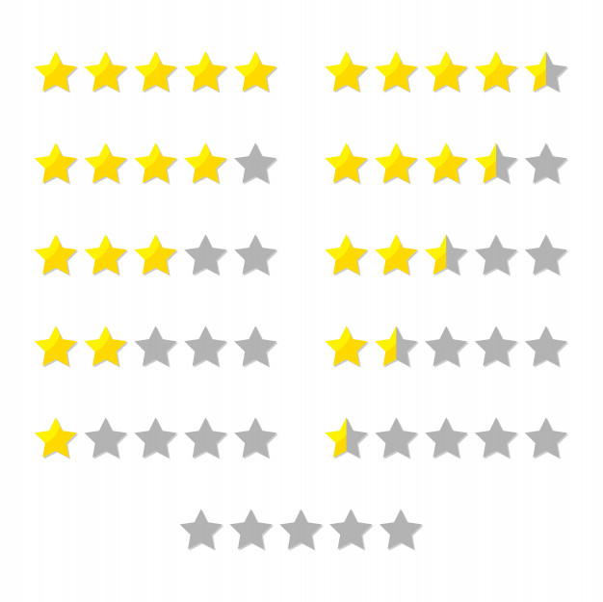
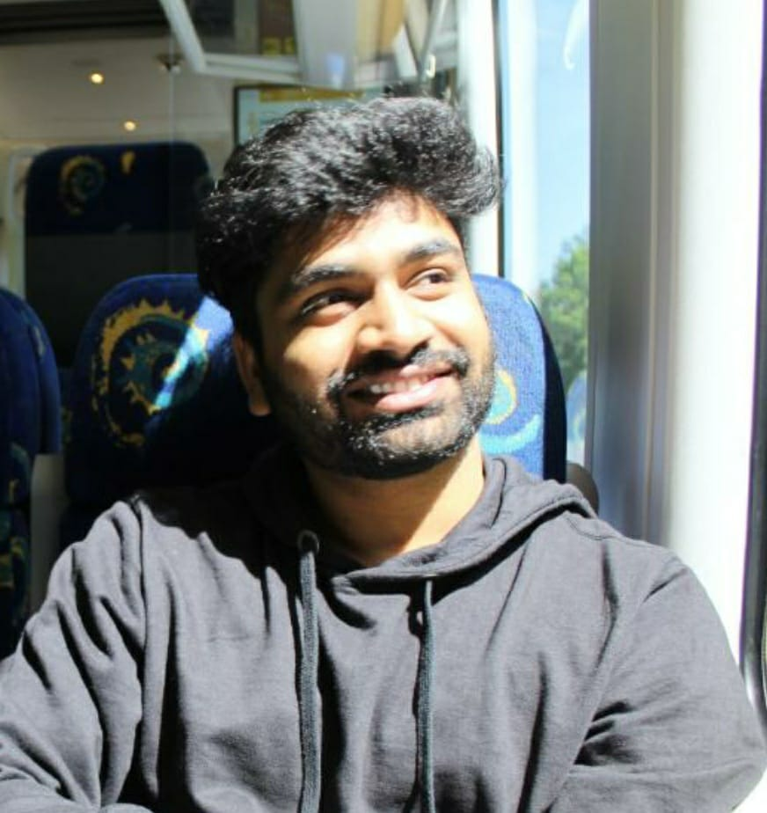
ISEE Project - Team DroidKnights
Milestone #5 - Product Presentation
Name
Designation
Review
Dilip Pathireddy
Student
The app is very easy to use and everything is very clear. It really gave me a visual idea of what is going on with my money, it should help me to control spending and I will be able to save money in the future.

Slide 16
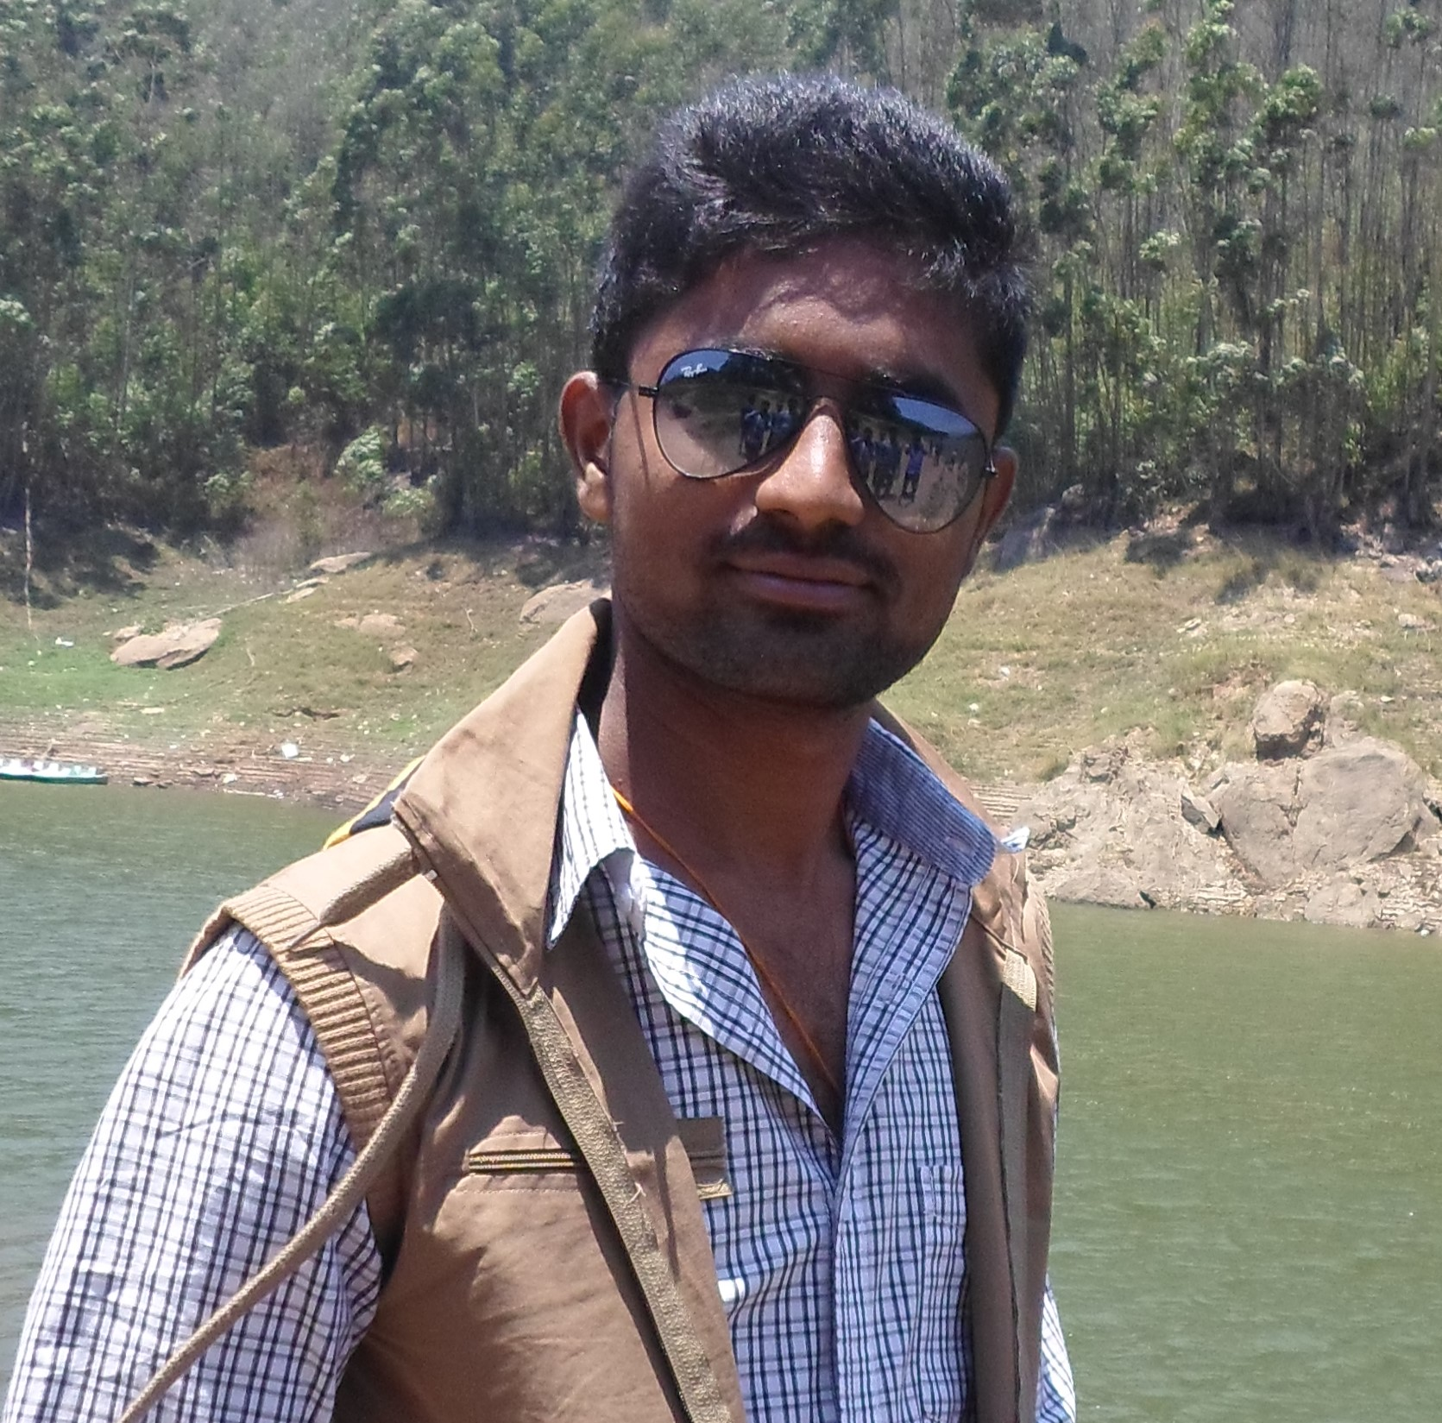
ISEE Project - Team DroidKnights
Milestone #5 - Product Presentation
Name
Designation
Review
Ravi
Software Engineer
App was very easy to use. The analytics was one of the feature that I liked the most and it was very visual. This app not only gave me the ability to add my expense and set budgets, but also helped me to understand my spending.

Slide 17
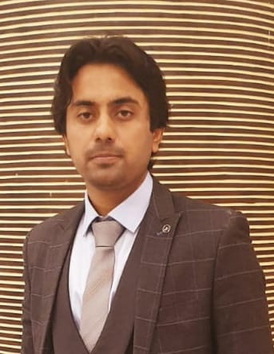
ISEE Project - Team DroidKnights
Milestone #5 - Product Presentation
Name
Designation
Review
Nazar Iqbal
Student
My initial thought being the app is not intrusive, its intuitive and simple. The graphical and analytical representation is impeccable and quite helpful from a student point of view. The export feature and recurring transactions adds silver lining to the App.

Slide 18
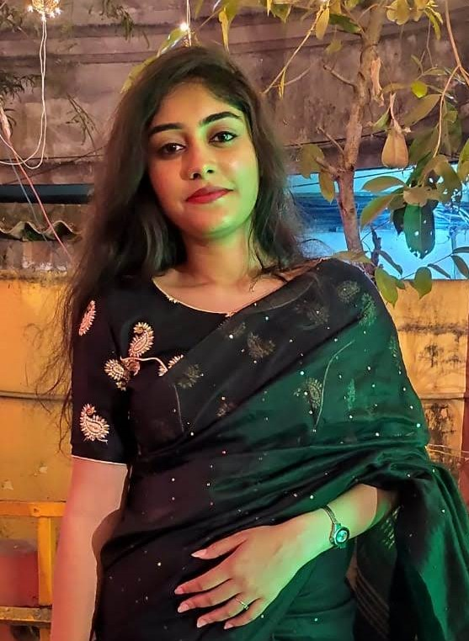
ISEE Project - Team DroidKnights
Milestone #5 - Product Presentation
Name
Designation
Review
Apurba
Cyber security analyst (trainee)
The user interface of the app is very simple and easy to use even for people who are not tech savvy. It contains all the features of a modern day app. The only thing that could get better is that if the password field compels user to input alphanumeric and special characters combination.

Slide 19
06
Lessons learned
ISEE Project - Team DroidKnights
Milestone #5 - Product Presentation
Individual lessons that we as a team learned while working on the project

Slide 20
Lessons learnt
ISEE Project - Team DroidKnights
Milestone #5 - Product Presentation
“Learning and Developing at the same time is a challenging phase, once done, gives a good feeling!!”
“There is nothing too hard to understand if you put yourself into situations where you have to provide solutions”
“Communication and division of workload are the key factors to produce a quality and hassle free teamwork”
“It is not so much about what the course hands you, but what you learn to do with it”
“When you work as a team, you grow as an individual”

Slide 21
07
Live demo
ISEE Project - Team DroidKnights
Milestone #5 - Product Presentation
Live demonstration of our app on the emulator

Slide 22
05
Thank you!
ISEE Project - Team DroidKnights
Milestone #5 - Product Presentation
Questions?

